Slide 1

2024 Spring Hill Public Works Annual Presentation
March 13, 2025

Slide 2

Departmental Organizational Chart
PUBLIC WORKS DIRECTOR
STREET/PARKS
SUPERVISOR
UTILITY
SUPERVISOR
FACILITY
SUPERVISOR
ADMINISTRATIVE ASSISTANT
(2) MAINTENANCE WORKER III
(1) MAINTENANCE WORKER II
(4) MAINTENANCE WORKER I
(1) MAINTENANCE WORKER I vacant
(2) WASTEWATER OPERATOR I
(2) WATER OPERATOR I
FACILITY MAINTENANCE
CUSTODIAN
(2) FACILITY WORKER (PT)
19 fte in 2024
20 fte at full staffing

Slide 3
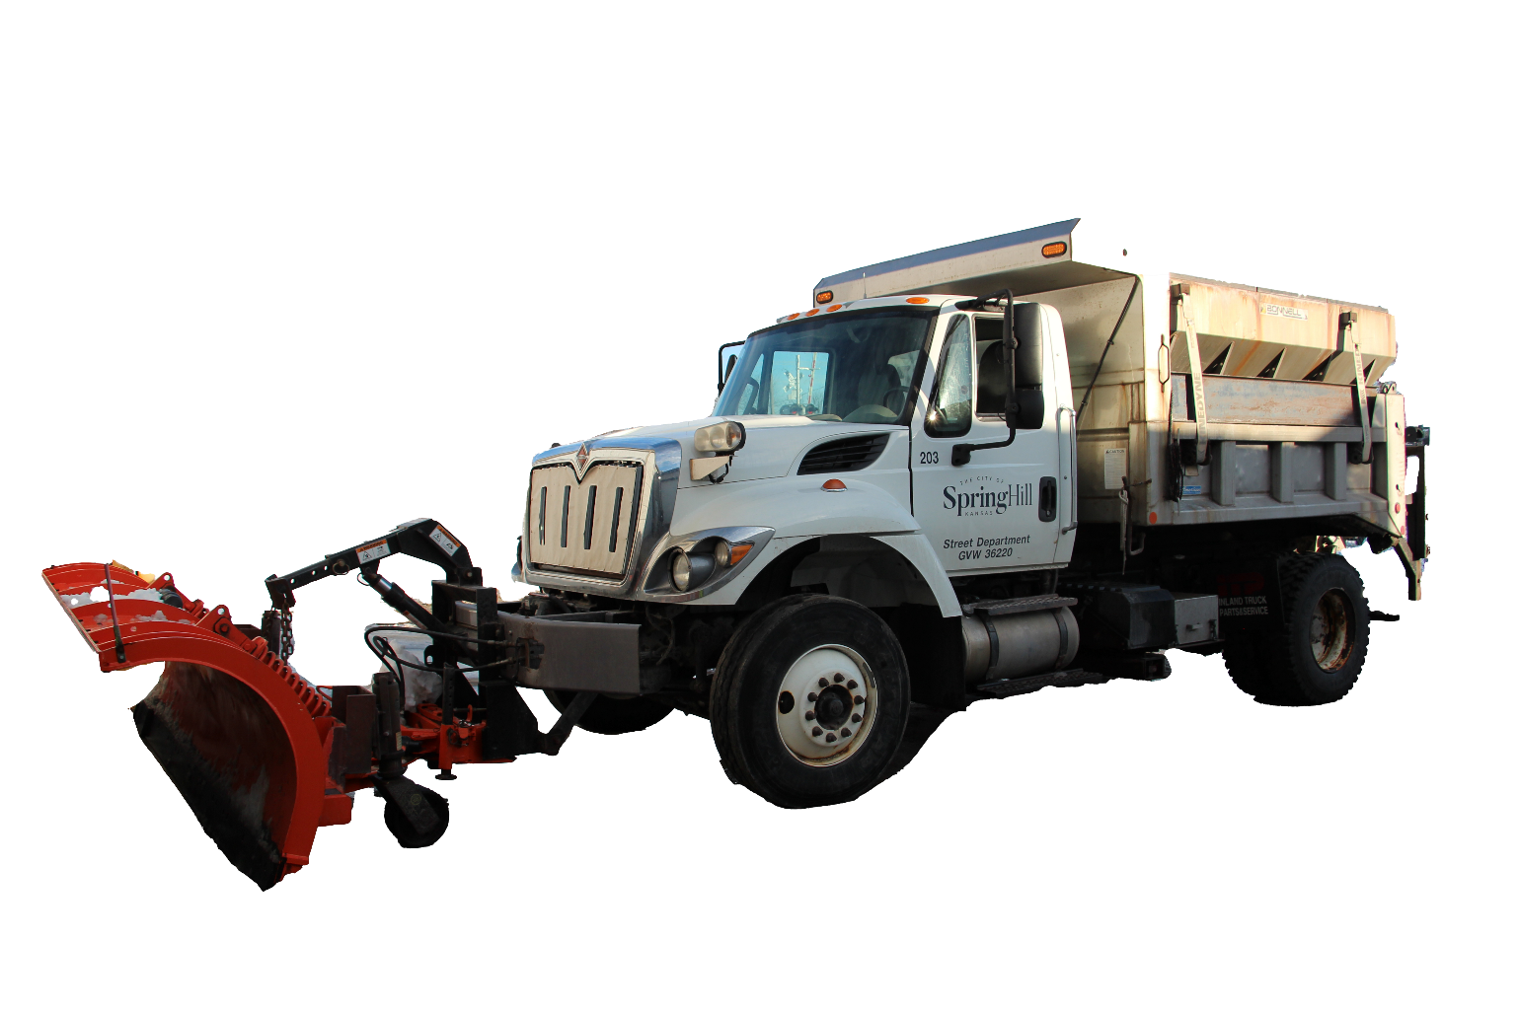
Streets/Parks Division
Maintained over 160 lane miles of roads
Miles of paved roads maintained by Spring Hill has increased 68% since 2013
Completed 190 Work Orders (184 previous year)
Placed 542.7 tons of asphalt (225.5 previous year)
Placed 252.4 tons of salt for winter road treatment (214.9 previous year)
Mow and maintain 110 acres of turf
Maintain 6 playgrounds

Slide 4
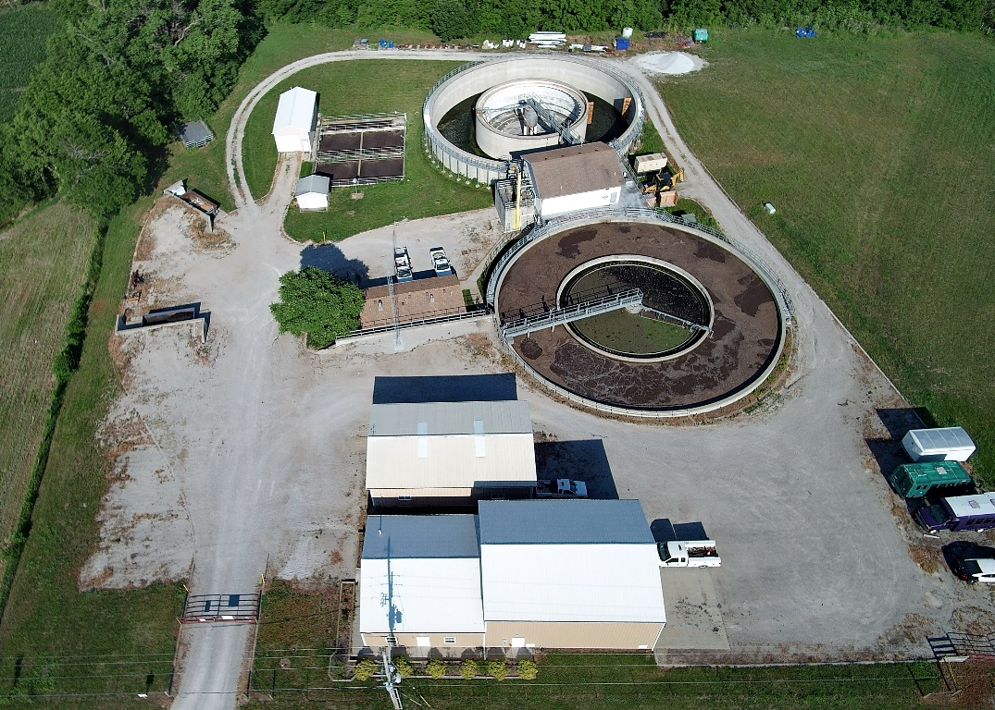
Utilities Division
Treated 248,009,000 gallons of wastewater (46% increase over 2017 levels)
Maintained 77.0 miles of sanitary sewer mains (38% increase since 2013)
Maintained 1,464 sanitary sewer manholes (+112)
Maintained 9 sanitary sewer lift stations
Corrected 2 sanitary sewer backups (-1)
Maintained 39.7 miles of water mains (6% over ‘13)
Maintained 2,095 water meters (+99)
Replaced 197 meters, installed 157 new meters
Repaired 1 water main breaks (-19)
Maintained 41.8 miles of storm water pipe (123% increase since 2013)
Maintained 1,627 storm water inlets (+120)

Slide 5
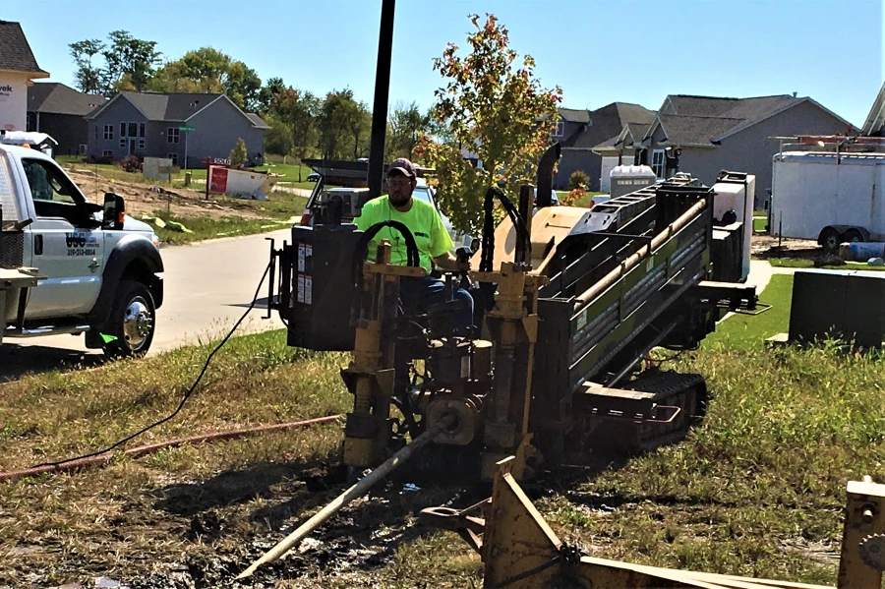
Right-of-Way Management
32 permit applications (87 previous year)
Plan review and approval for fiber optic installations, driveway approach construction, etc.
Liaison between residents and utility companies for questions and complaints.

Slide 6
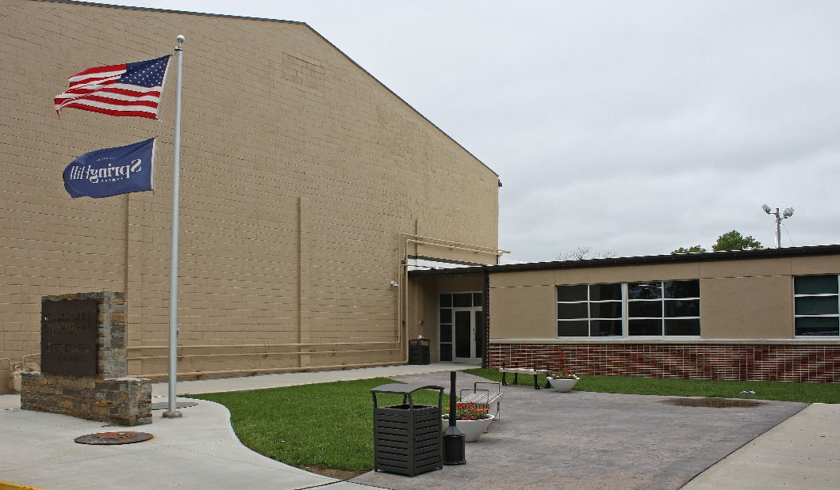
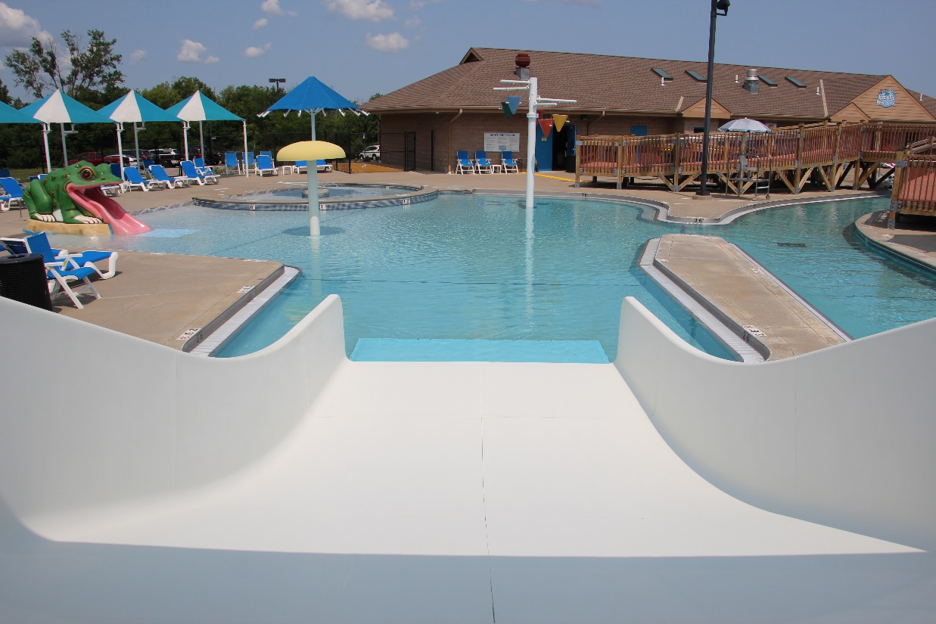
Facility Maintenance Division
Maintained 53,390 square feet of buildings
8 facilities
Monitored 1,747 facility reservations (1,665 previous year)
Served 19,845 patrons at the Spring Hill Aquatic Center (22,833 Previous year)

Slide 7
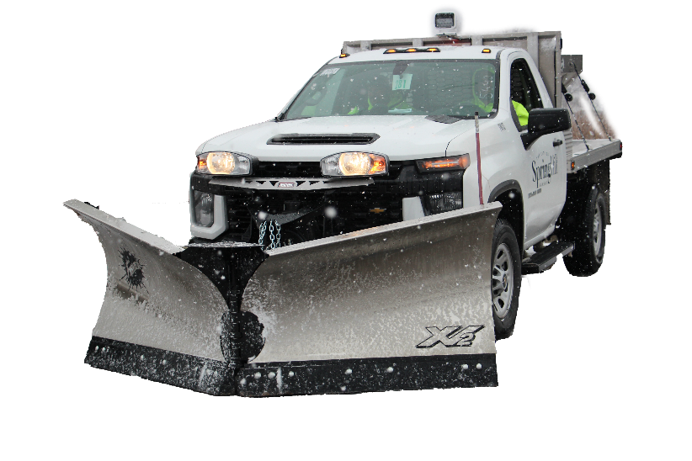
2024 Summary of Activities
Continued annual street maintenance and repair program
Began implementation of asset management and work order software system
Initiated process to expand the City’s wastewater treatment capacity
Enhanced training and professional certifications for staff
Inventoried all water service lines in accordance with federal and state mandated lead & copper program
Developed and implemented storm water utility to expand revenue sources and meet requirements for storm water program
Began analysis of operational structure, staffing levels, and equipment inventory to maximize efficiency of the department

Slide 8
Questions?

